Slide 1
Oreilly – Helm

Slide 2
What is Kubernetes
A portable extensible plaform for managing containerized workloads and servers ( cluster orchestration system)
  The containers can be scaled, monitored and restarted either manually or automatically
  Goal provide a robust platform for running many containers
Groups of containers that make up an application into logical units for easy management
Provides a framework to run a distributed system of containers resiliently
Takes care of
  scaling
  failover
  deployment patterns
Terminology
  Cluster – An High Availability set of computers coordinated by k8s to work a unit
    Has the master nodes and worker nodes
  Pods – Object that contains and manages one or more containers and any attached volumns
  Service – Abstraction that groups together pods based on identifiers called labels ( or other characteristic)
    Has a virtual port that you connect to and is able to talke to a set of pods and direct traffic ( load balancer )
  Deployment – Define a stateless app with a set number of pod replicas ( scaled instances)
    Know how to continue where it left off.
  Ingress – resource that lets cluster applications be exposed to external traffic
  Namespace – A logical area that groups k8s items such as pods

Slide 3
What is Kubernetes
Understanding Kubernetes Objects
  To work with k8s, object use the k8s API
    kubectl command line makes calls to API for you
    k8s api client libraries
  K8s objects are persistent objects in the k8s Systems
    Ex. if it drops down from 5 to 4 pods then K8s will put it back to 5
    declarative modes
  K8s use these entities to represent the state of the cluster
    They can describe
      What application containers are running and on which nodes
      Resource available to applications
      Policies around how those applications behave
  Kubernetes object is “record of intent”
    After creation k8s will work to ensure object exist
    Creating an object declared what you want cluster workload to look like
    known as the desired state

Slide 4
What is Kubernetes
Kubernetes is a desired state system
  User supplies desired state via declaring it in manifest
    A set of YAML Files which is the desired state
    A set of reconciliation processes which makes sure the current ( observed state ) matches the desired state
  Kubectl apply // can take YAML files as input and update the cluster based on specs
  kubctl get -o yaml // Dump out spec and status as YAML from running

Slide 5
What is Kubernetes
When creating an object in k8s have to provide
  object spec to describe desired state
  basic info – ex. name
Required fields
  apiVersion – which version of the k8s API is being used to create the object
  kind – What kind of object to create
  Metadata – Data that helps uniquely identify the object such as
  name, UUID, namespace
  Object Spec
    Format different for every k8s object
    Contains nested fields specific to the object
    Can find details on specs in the API Reference

Slide 6
What is helm
Package manager and lifecycle manager for k8s
  Take sets of manifest and package them as a unit ( think application)
  Once deployed we have a running instance
Bundles related manifest into a chart
  When installing a chart helm creates a release
The release has a lifecycle which can be create, installed, upgraded, rollback, deleted, versions and have status reported
Benefits
  Templating
  Repeatability
  Reliability
  Multiple Environment
  Ease of collaboration
Installing
  https://github.com/Kubernetes/helm/releases
  helm version
  helm env
  Use the cluster/host via config file
    ~/.kube/config Helm reads to get information about the cluster

Slide 7
What is Helm
Why do we need Helm
  Microservice = pod + deployment + replication set + Ingress + Service Times + # of microservices
  Duplication of values across objects – common values used in different services
  Hard to override values ( no parmaterization )
  Manage the lifecycle of all objects is challenging
With help we can install what is in the chart
Advantageous of using HELM
  Saves having to deploy multiple individual manifest ( for multiple kubernetes objects)
  Allows for reuse via parameterizing ( templates)
  Simplified mechanism for finding and deploying popular software ( package as Helm charts )
  Makes it easier to share your applications ( via charts)

Slide 8
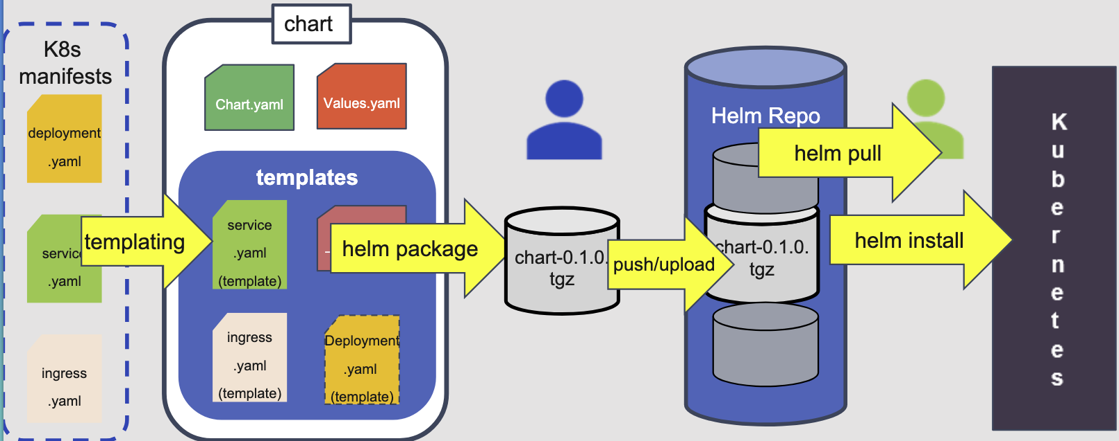
What is Helm
Kubernetes files are templated
Templates and related files are structured as a chart
charts are packaged
Packages are stored in repos for easy use by others
Charts can be pulled ( downloads) and optionally unpacked (untar)
Charts are installed from repos ( with values ) as releases into Kubernetes

Slide 9
What is Helm
Chart Repository
  Location where Hem charts can be stored and shared
  Able to serve yaml and tar files
    Helm package format is tar file
    Index file for repo is YAML
  Response to REST API GET Requests to get Packages
  Many storage options available
  Helm instance can have many different repos defined/added.
Chart Museum
  An open source Heml chart repository
  chartmuseum.com
  pluginbs for simplifying, packaging and uploading

Slide 10
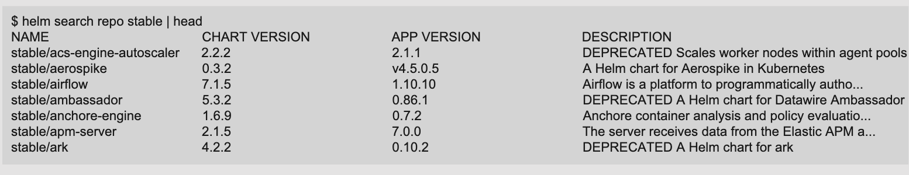
Helm Commands
Show all repositories
  helm repo list
Add a Repo
  helm repo add <repo> url
    helm repo add stable https://kubernetes-charts.storage.googleapis.com
Search a repo
  helm search repo <repo> <chart name>
    hem search hub
remove a repo
  helm repo rm <repo>

Slide 11
Helm Topology
Chart a package ( A bundle of k8s resources)
Release – A chart instance loaded into k8s
  Same chart can be installed several time into the same cluster
  Each such chart will have its own release
Repository – A repository of published charts
Template - a K8s Configuration file mixed with Go/Sprig Templates
List of Helm Charts

Slide 12
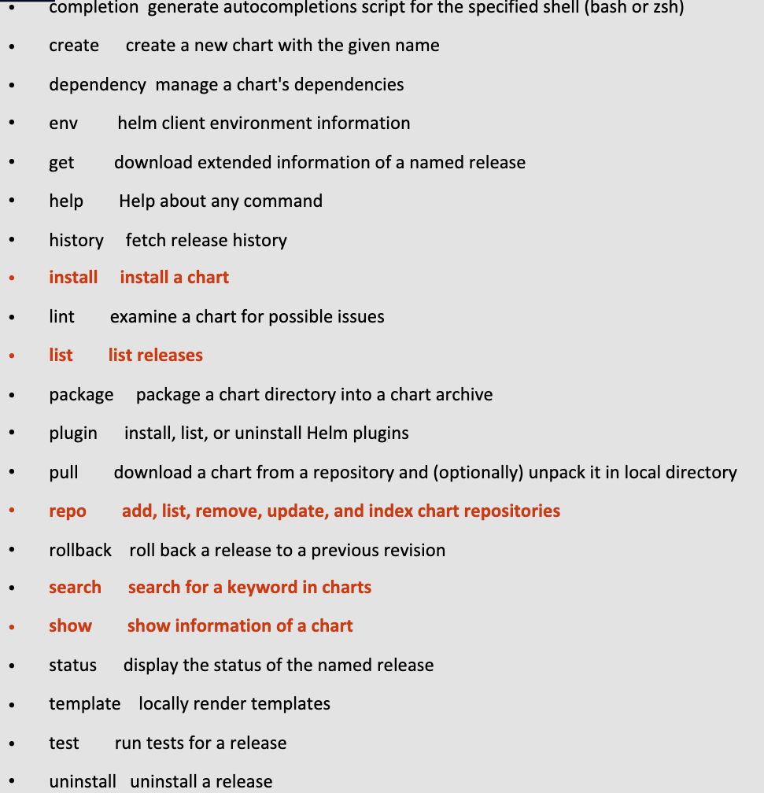
Helm Commands

Slide 13
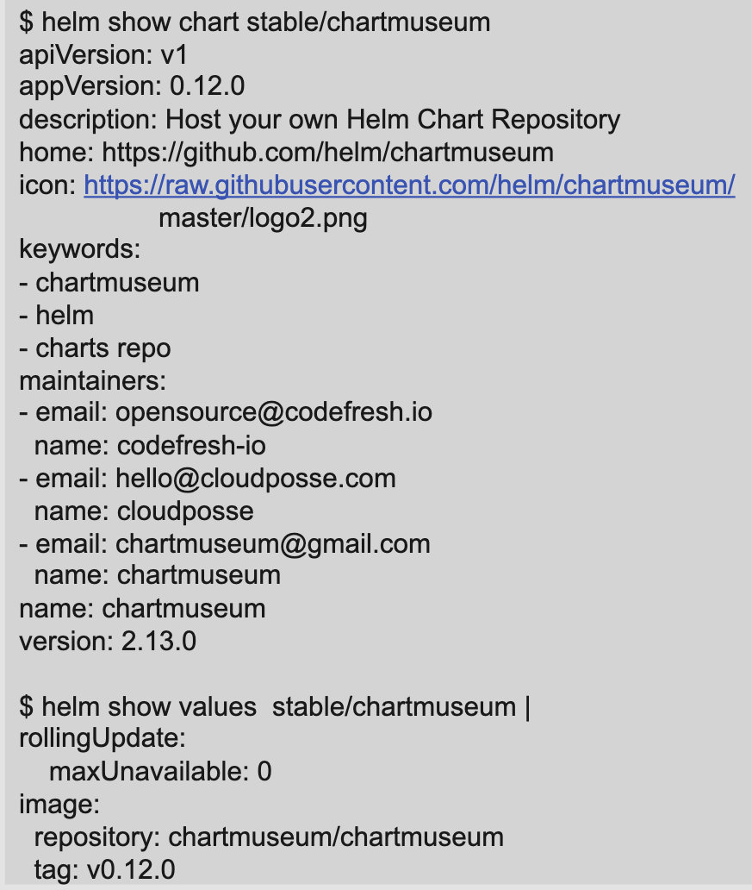
Helm Commands
helm show chart <repo>/chartname> // shows information from a chart
  version of the chart and version of application
helm show chart // shows a chart definition
helm show readme // shows a chart’s readme
helm show values // shows a charts values
helm show all // Show all the information from a chart
Helm install a Chart
  helm install <chart>
    Talks to the API Server in the cluster and creates the service, deployment, ingres etc…
    Kubernetes runs the reconciliation loop
    Combines the values and the templates

Slide 14
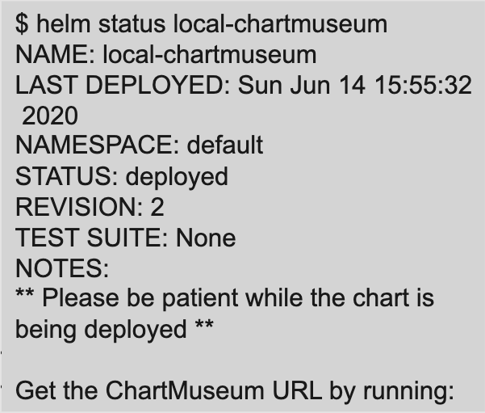
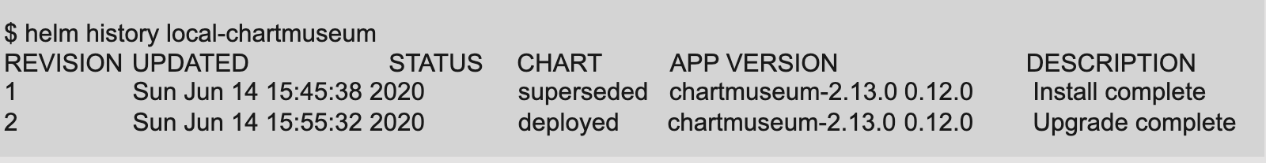
Helm Commands
Getting information about Releases
  A release is an instance of a Helm Chart deployed in Kubernetes
  The release can be different from the chart name
  helm list // list of releases
  helm status RELEASE_NAME [flags] // See current status
  hem history RELEASE_NAME [flags]

Slide 15
Helm Commands
Helm status
  Status Fields
    last deployment Time
    k8s namespace where release is
    State of the release ( see sidebar )
    List of resources sorted by any kind
    Details on last test run ( if any )
    Additional notes provided by chart
Release States
  unknown
  deployed
  uninstalled
  failed
  uninstalling
  pending-install
  pending-upgrade
  pending-rollback
helm status local-chartmuseum

Slide 16
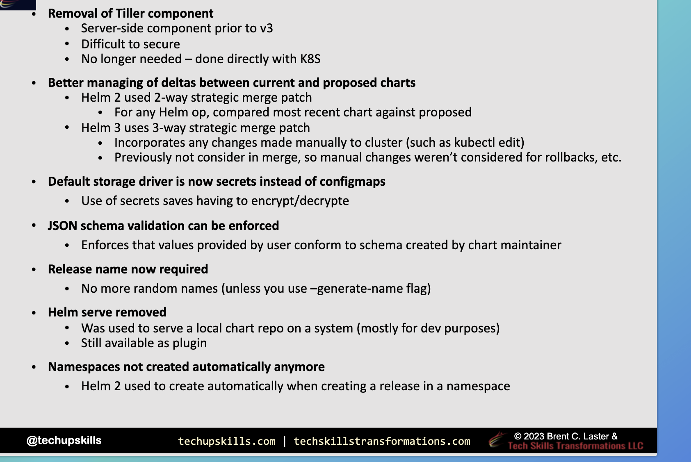
Helm Commands
helm upgrade <release> <chart>
  use --set to override chart settings
helm rollback <release> <revison>
  looks at the history
  When you do a rollback you are still getting a
  new incremented release.
Don’t use Helm 2 -----------------------------------------------------
helm upgrade has the --force
Deployment status is kept in the secret storage which is
the default storage

Slide 17
Charts
Packing format for helm
  defines resource, values and helper template to make an application
Define a way to compose a set of K8S resources and values to make up deployment
Deployable Unit
  can be installed, updated, removed
Can be versioned and mangaged in source control and compress in packages
Chart can include other charts as dependencies
Makes it easier distributable for others to consume
  One install vs many
Generating new Charts
  helm create command
  creates a scaffold directory/file structure
  helm create myChart

Slide 18
Charts
Structure
  Helm charts have an explicit structure
  Not all elements have to be present
  override a value --set

Slide 19
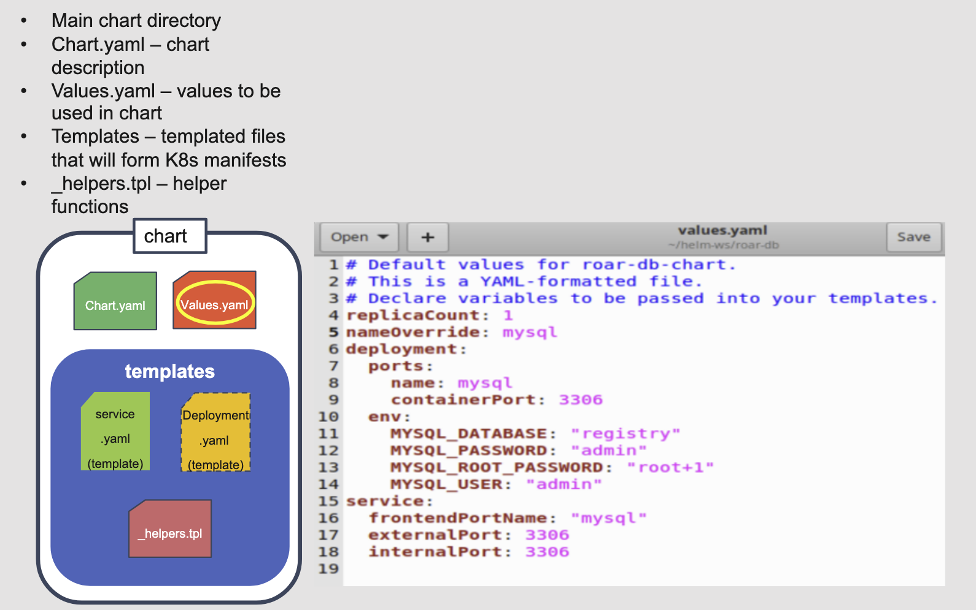
Charts
Example Files in Helm Chart
  ._helper.tpl – extra functions to process data
  If it start with _ then it is not part of the deployment

Slide 20
Charts
Charts.yaml File structure

Slide 21
Charts
Optional Supporting Files
  License
    plain text file containing license for the README
  README.MD
    Markdown format
    Displayed if user does “helm show readme”
    Can be used to provide configuration info, urls, explanations, etc
  templates/NOTES.txt
    used to display instructions or meaningful info to users
    Shown at the end of a helm install or upgrade
    plain-text, but process as a template ( all template functionality available)
    Strongly Recommended

Slide 22
Templates
Locally rendering templates
  helm tempalte NAME CHART [flags]
  render templates locally and display output
Download manifest for a named release
  helm get manifest RELEASE_NAME [flags]
  manifest
    YAML encoded version of K8s resources generated from chart
  Dry Run
    helm install NAME CHART [flags] –dry-run --deubg

Slide 23
Test
Running Test in Helm
  Basic Test for deployed charts
  can be included in tests subdir

Slide 24
Deleting a Release
Uninstalling a release
  helm uninstall RELEASE_NAME
  Removes all resources that were part of last release
    Remove release history too

Slide 25
Templates Directory
Understanding Templates
Top Level Objects
Location where Helm looks for the YAML definitions for Rubbernecks object ( deployments, services, etc)
YAML files can be templated ( have placeholder for reusable values to be inserted )
Helm run each file in the directory through a GO Template rendering engine
When placeholder are filled in by running Heml you end up with a standard K8S manifest
Understanding Templates
  Template directives are put between {{ and }}
  Values passed inside the blocks are named space objects ( use the dot notation)
In the template file can have chart: {{ .Chart.Name }}-{{.Chart.Version | replace “+” “_” }}
can even do conditional checks
Screenshot – Top Level Objects

Slide 26
Settings Values – Hierarchy/Order of Precedence
.Values is a top level object in Helm
Provides access to items passed into chart
Items come from
  various value.yaml file
  if in a subchart the values .yaml of a parent chart
  a different file pased in to a helm instlal or helm upgrade with the -f flag
    helm install -f myvalues.yml ./myChart
  parameters passed with the --set on the comand line
Items in the list above override from top-down ( --set overrides everything )

Slide 27
Helm Versions
version
  Every chart.yaml is required to have a version number
  version must follow the SemVer2 standard
    Given a version number MAJOR.MINOR.PATCH increment the
      MAJOR version when you make incompatible API Changes
      MINOR version when you add functionality in a backward compatible manner
      Patch – Backwards compatible bug fixes
      Additional labels fro pre-release and build metadata re available as extensions to the MAJOR.MINOR.PATCH
    version numbers used in release package names
    package name = name + version
  apiVersion – v2 for charts needing Helm 3 as minimum or using Helm 3 Features
  appVersion
    specific version of the application managed by Chart
  KubeVersion
    can be used to define which k8s versions are supported
    if present Helm wil check when installing chart and fail if version k8s is not supported
    Can get very specific ( >=1.12.1 < 1.14.0 || >=1.14.2 )

Slide 28
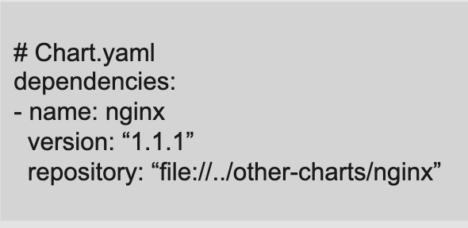
Dependencies
At some point may need to pull in another chart/app as a dependency
Helm allows for identifying other charts that will be pulled in as part of a release
To define a dependency add dependencies seciton in Chart.yaml
Deprecated method – create requirements.yaml in the chart root direct
when dependencies are being updated, lockfile is generated so that later fetches of dependencies use a working know version
Managing Helm Dependencies
  Helm charts store their dependencies in charts/
  Should be declared in “dependencies” block in Chart.yaml
  Commands:
    dependency build, dependency list, dependency update
  Dependency Fields
    name – name of chart must match name in others chart’s
    Chart.yaml file
    version == semantic version or version range
    repository == url or path to chart

Slide 29
Dependencies
Manage dependencies between charts
  Helm 3 has dependencies section in Chart.yaml
  When dependencies are being update, lockfile is generated so that later fetches of dependencies use a working known version
helm dep up // update dependencies
Managing Dependencies between Charts
  Full chart in subdirectory
  Previous ( but still supported ) mechanism via requirement.yaml
  Helm v3 supports “dependencies” section in Chart.yaml

Slide 30
Packing and Uploading files
helm package creates Helm package as tar file
Can upload directly to repo
May alos require index.yaml generation and uploads
Plugin for Helm add helm push to do all of this using ChartMuesume

Slide 31
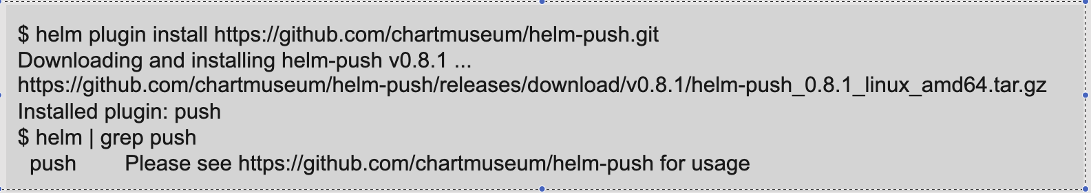
Helm Plugins
helm plugin install <path|url> – Install Plugins
helm plugin list – List Plugins
help plugin update <plugin> – Update Plugin
help plugin uninstall <plugin> – Uninstall Plugin

Slide 32
Helm Ignore File
Used to identify files to not be included in a helm chart
Helm package will ignore files matching patterns in here
Supports relative paths, unix globbing, and negation with !
named .helmignore

Slide 33
About Objects
Template Objects
Objects passed into templates from templating engine
Object can be passed around and manipulated
Objects can have one to many values ( subobject)
Objects can have functions that are callable
Template Functions
  Allows you to transform data passed into a template
  function syntax – funcitonname arg1 arg2
  Over sixty funcitons available to use; provide by
    Go tempate language
    Go Sprig template library
    Examples : upper, quote, eq

Slide 34
Anatomy of a Helm Function
template functions
  typically stored in _helpers.tpl
  Have a description / name / body
Helm uses Go Templates to instrument manifest ( mixed with extra functions and wrapper to expose object to templates )
Helm has almost all of the Sprig library funcitons
custom functions usually defined in _helpers.tpl
  Any file that starts with “_” in templates directory is not expected to produce a usable k8s file
template function
  Allows you to pull in a template in your *.yaml file
  Example {{ tmplate “myFunciton” . }}
Include function
  Allows you to include a tempate and pass results to other functions
  Example: {{ include “myFunciton” . | upper | quote }} // Pipeline ( | ) – pipe output of one function to another
required function
  Allows you to evaluate string as templates within a template
  Example Given .Values.template=”{{.Values.version}}” and .Values.version=”1.0” then {{ tpl.Values.template . }} = “1.0
default function
  Allows you to specify a default value in a template, in case the value is omitted
  myItem {{ .Values | default “foo” }}

Slide 35
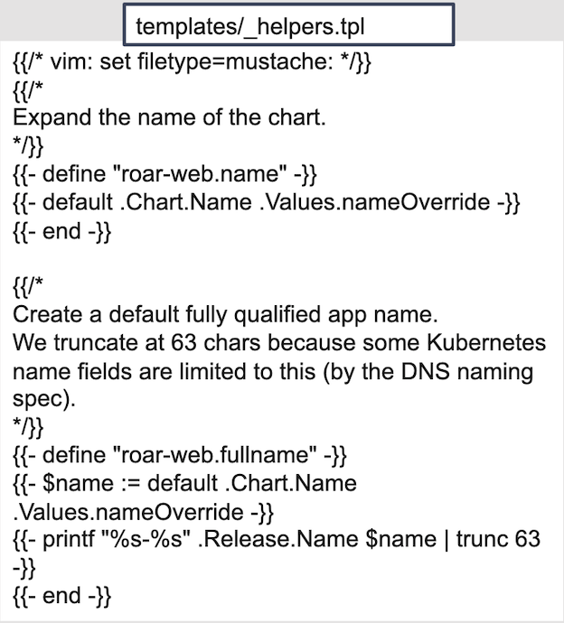
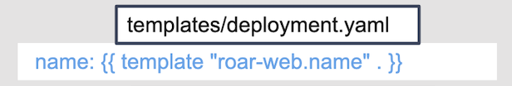
Anatomy of a Helm Function
Template functions
  Typically stored in _helpers.tpl
  Have a description / name / body

Slide 36
Pipelines
Dealing with Defaults in Helm
Similar to the idea of Unix pipelines
  allows changing together multiple template commands
  simplify doing multiple things in a sequence
  When pipelining arguments result of previous evaluation is sent as last argument to next one
    {{ first evaluation | function arg1 }} == {{ function arg1 arg2 }} where arg2 is the first evaluation
    Example
      name: {{ .Values.user.name | upper | quote }}
Dealing with default in helm
  Can use helm default function
  If you don’t want a default value set override with nul – hem install mychart --set <template>.<value>=null
  If there is not a good default vfalue or you want to always have a user-supplied value use the requires function
    {{ required “A valid value is requred for think” Values.thing }}

Slide 37
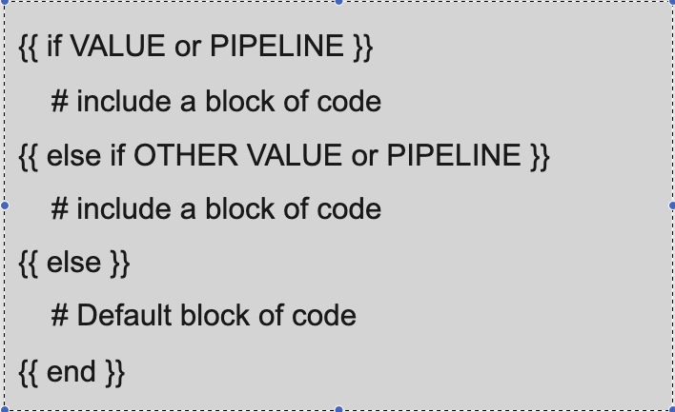
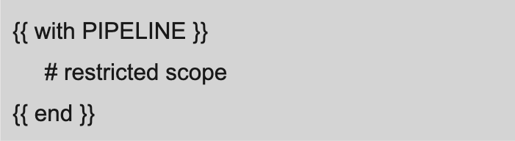
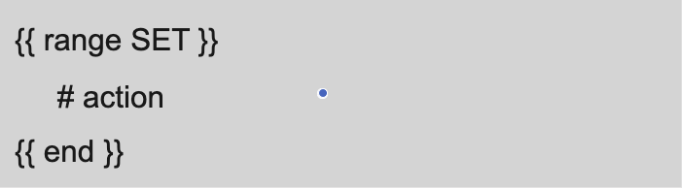
Flow Control
Conditionally include blocks of text in a template
if else
  false evaluates to
    boolean false
    numeric 0
    empty string
    nil ( empty or null )
    empty collection
  else true
Limit Scope
  with “.” is reference to current scope
  can limit scope such as {{ - with .Values.subitem }}
If example
  {{ if value or PIPELINE }}
    # include a block of code
  {{ else if other value or PIPELINE }}
    # include a block of code
  {{ else }}
    # Default block of code
  {{ end }}

Slide 38
Flow Control
{{ with Pipeline }}
  # restricted scope
{{ end }}
{{ range SET }}
  #action
{{ end }}

Slide 39
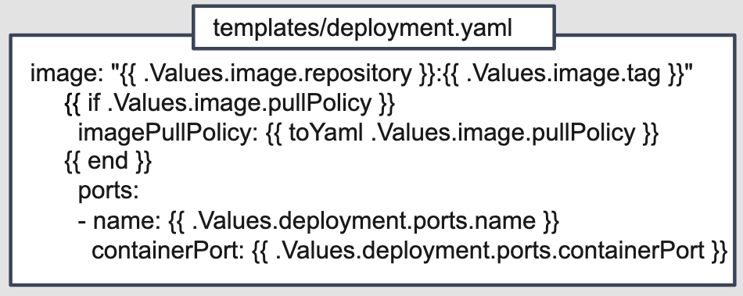
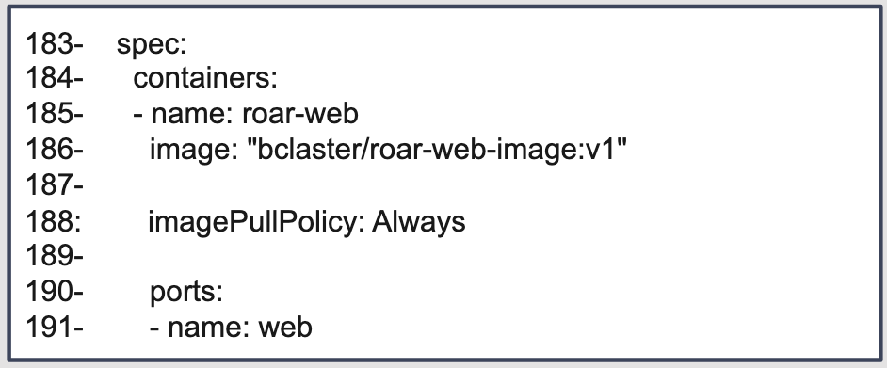
Managing WhiteSpace
Variables
Helm renders yaml files, whitespace is very important
  Helm renders removes brackets, but not newlines or white spaces
  {{-, -}} remove preceding/following whitespace
nidinent – like indent but adds a new line in rendered output
Variables
  named reference to another object
  name of variable is $name
  assign values with :=
  uses
    assign variables os that you can reference
    $name even if object is not in scope
    in range loops can be used to get both index and value
    example {{- $rname := .Release.name -}}

Slide 40
Variables
named reference to another object
name of variable is $name
assigned values with :=
uses
  assign variables so that you can reference $name even if object is not in scope
  in range loops can be used to get both index and value
example
{{- $rname := .Release.name -}}
The picture in next slide is to pring key/value pairs.

Slide 41
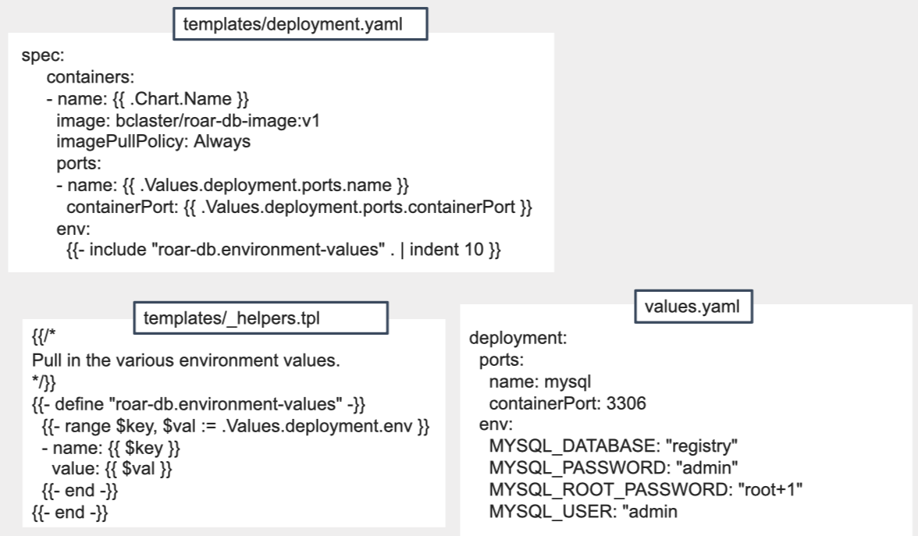
Variables

